Slide 1

Mailing Application Six weeks Industrial Training Report at HCL INFOSYSTEM Submitted by:- Student Name:-Kritika Pandey DEPARTMENT OF COMPUTER SCIENCE& ENGINEERING Mahaveer Swami Institute Of Technology 2017

Slide 2
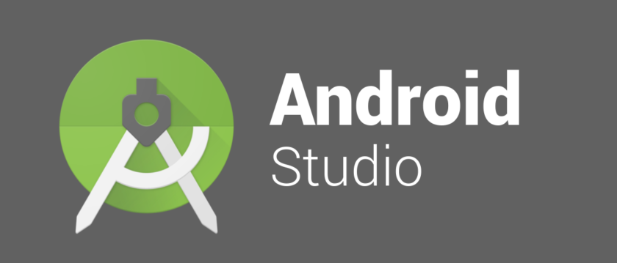
INDEX
INTRODUCTION
What is Android Studio ???
OUTLET OF ANDROID
HARDWARE SOFTWARE USED
EMULATOR
JAR FILES
FIREBASE
Code
Smtp
Attachment
Output

Slide 3
INTRODUCTION
Why I choosed android studio as my project ?
This project is a mailing app which is constructed using both forms
Code → java coding
Design →xml
It provided exposure towards evergreen and demanding technology of android .
In todays world where speed has become the need of generation hence every technology should be used effectively.
Everyone from rich to poor is having android phone therefore I decided to learn to develop an app which could match with todays pace and help those who don’t have time to run those laptop and computer for small and essential work
Nowdays this type of apps are launched and installed in phone where work of hours can be done in seconds,similarly my mailing app allows user to excess their email id on phone and send mail
For building this app only requirement is knowledge of basic android studio ,java lang and creativity
If all these are in favour it becomes easy to develop the application

Slide 4
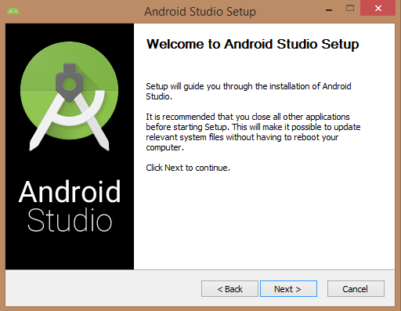
What is Android Studio ???
Android Studio is the official integrated development environment (IDE) for Google's Android operating system, built based on JetBrains' IntelliJ IDEA software and designed specifically for Android development. It is available for download Windows, macOSand Linux, and replaced the Eclipse Android Development Tools (ADT) as Google's primary IDE for native Android application development
Gradle-based build support
Android-specific refactoring and quick fixes
Lint tools to catch performance, usability, version compatibility and other problems
ProGuard integration and app-signing capabilities
Template-based wizards to create common Android designs and components
A rich layout editor that allows users to drag-and-drop UI components, option to preview layouts on multiple screen configurations
Support for building Android Wear apps
Built-in support for Google Cloud Platform, enabling integration with Firebase Cloud Messaging (Earlier 'Google Cloud Messaging') and Google App Engine
Android Virtual Device (Emulator) to run and debug apps

Slide 5
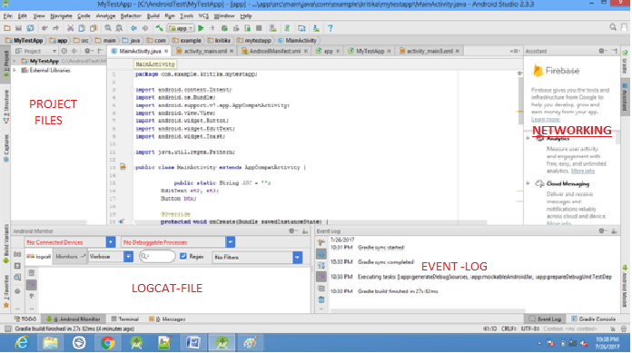
OUTLET OF ANDROID

Slide 6
Hardware used 64 bit windows 8 4 GB RAM Software used Android studio 2.3.3 Jar files Activation.jar Additional.jar Mail.jar For connectivity to serve firebase is used

Slide 7
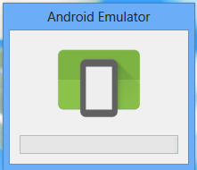
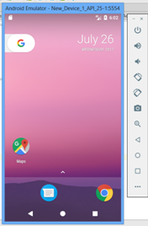
EMULATOR
In android studio latest version 2.3.3 has emulator attached otherwise it has to be downloaded
It is basically a device like android phone developed in software so tha connectivity with phone is not required while making software

Slide 8
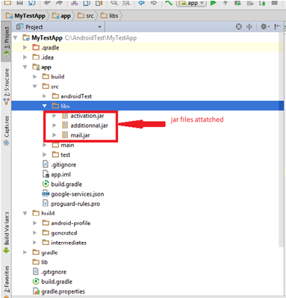
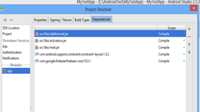
JAR FILES
A JAR (Java ARchive) is a package file format typically used to aggregate many Java class files and associated metadata and resources (text, images, etc.) into one file for distribution.[
JAR files are archive files that include a Java-specific manifest file. They are built on the ZIP format and typically have jar file extension.
It has 3 jar files:-
Activation.jar
This JAR (Java Archive) file containing the classes that make up JavaBeans Activation Framework.
Additional.jar
Mail.jar
I've added mail.jar to the server's CLASSPATH.Web application uses Java Mail to attach and send a file that the user specifies

Slide 9
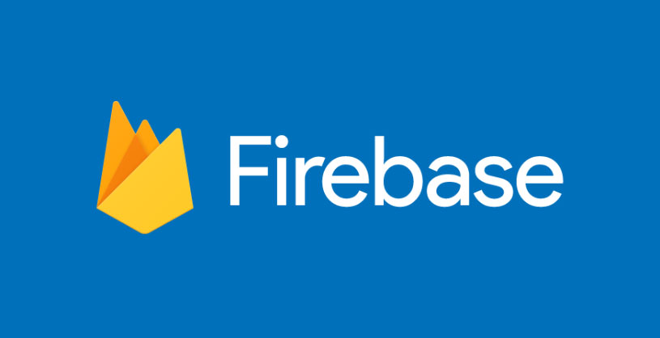
The Google Play services SDK from the Google Repository, available in the Android SDK Manager
Add Firebase to your app
If using the latest version of Android Studio (version 2.2 or later), Firebase Assistant is used to connect app to Firebase. The Firebase Assistant can connect your existing project and install any necessary gradle dependencies.
To open the Firebase Assistant in Android Studio:
1) Click Tools > Firebase to open the Assistant window.
2) Click to expand one of the listed features (for example, Analytics), then click the provided tutorial link (for example, Log an Analytics event).
3) Click the Connect to Firebase button to connect to Firebase and add the necessary code to your app.

Slide 10
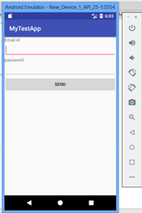
CODE
I have created two text box which ask for email id and other text box ask for password
Then there is a button created which is used to login
When we enter email id It is checked for validity purpose by matching of code
If it is invalid it shows invalid id
private boolean isValidEmaillId(String email) { return Pattern.compile("^(([\\w-]+\\.)+[\\w-]+|([a-zA-Z]{1}|[\\w-]{2,}))@" + "((([0-1]?[0-9]{1,2}|25[0-5]|2[0-4][0-9])\\.([0-1]?" + "[0-9]{1,2}|25[0-5]|2[0-4][0-9])\\." + "([0-1]?[0-9]{1,2}|25[0-5]|2[0-4][0-9])\\.([0-1]?" + "[0-9]{1,2}|25[0-5]|2[0-4][0-9])){1}|" + "([a-zA-Z]+[\\w-]+\\.)+[a-zA-Z]{2,4})$").matcher(email).matches(); Other wise if it is valid it enters next page
For this I have created if else loop
public void onClick(View v) {
if (isValidEmaillId(et2.getText().toString().trim())) {
Toast.makeText(getApplicationContext(), "Valid Email Address.", Toast.LENGTH_LONG).show();
Intent intent = new Intent(MainActivity.this, Main3Activity.class);
startActivity(intent); }
else {Toast.makeText(getApplicationContext(), "InValid Email Address.", Toast.LENGTH_LONG).show();

Slide 11
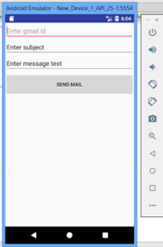
Then I have created three text box which ask for email id to whom mail has to be send and other text box ask for subject
And the last text box is for message
Then there is a button created which is used to submit
And all the text box are string type
reciep = (EditText) this.findViewById(R.id.et_to); sub = (EditText) this.findViewById(R.id.et_sub); msg = (EditText) this.findViewById(R.id.et_text); Button Login = (Button)this.findViewById(R.id.btn_submit); Login.setOnClickListener(this); } @Override public void onClick(View v) { rec = reciep.getText().toString(); subject = sub.getText().toString(); textmessage = msg.getText().toString();

Slide 12
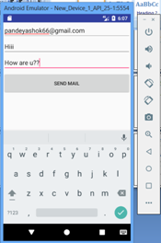
Simple Mail Transfer Protocol
Simple Mail Transfer Protocol (SMTP) is an Internet standard for electronic mail transmission.It was last updated in 2008 with Extended SMTP additions by RFC 5321, which is the protocol in widespread use today.
Although electronic mail servers and other mail transfer agents use SMTP to send and receive mail messages, user-level client mail applications typically use SMTP only for sending messages to a mail server for relaying.
SMTP communication between mail servers uses TCP port 25. Mail clients on the other hand, often submit the outgoing emails to a mail server on port 587. Despite being deprecated, mail providers sometimes still permit the use of nonstandard port 465 for this purpose.
SMTP connections secured by TLS, known as SMTPS, can be made using STARTTLS.
Although proprietary systems (such as Microsoft Exchange and IBM Notes) and webmail systems (such as Outlook.com, Gmail and Yahoo! Mail) use their own non-standard protocols to access mail box accounts on their own mail servers, all use SMTP when sending or receiving email from outside their own systems.
props.put("mail.smtp.host","smtp.gmail.com"); props.put("mail.smtp.socketFactory.port","465"); props.put("mail.smtp.socketFactory.class","javax.net.ssl.SSLSocketFactory"); props.put("mail.smtp.auth","true"); props.put("mail.smtp.port","465");

Slide 13
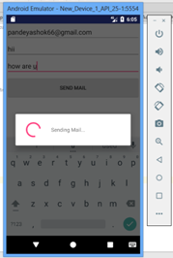
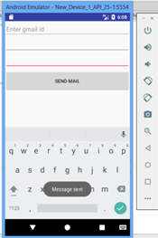
When we are able to connect to port and check email id of receiver then this is used for sending mail It shows a message “sending mail”
pdialog = ProgressDialog.show(context,"","Sending Mail...",true); RetreiveFeedTask task = new RetreiveFeedTask(); task.execute();
when we are successful in transfer of message it shows
“Message Send”
This is the code used
Toast.makeText(getApplicationContext(),"Message sent",Toast.LENGTH_LONG).show();

Slide 14
ATTACHMENT OF JAR FILES AND FIREBASE
Download 3 files
Activation .jar
Additional.jar
Mail.jar
I've added mail.jar to the server's CLASSPATH.Webapplication uses Java Mail to attach and send a file that the user specifies
Then in project structure set the path or these jar files
Then attach it to library
My test app →app →src →libs
Last step is to connect your file to server using firebase by login to admob in order to make add of application

Slide 15
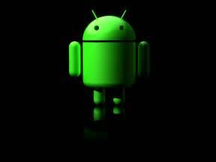
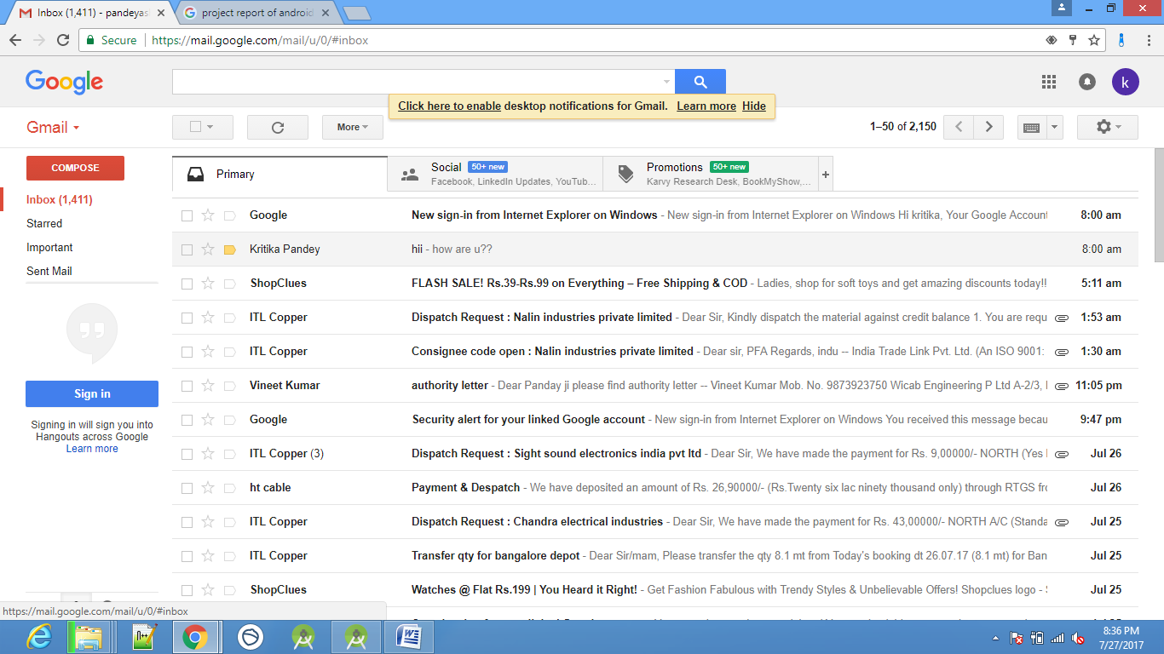
OUTPUT

Slide 16
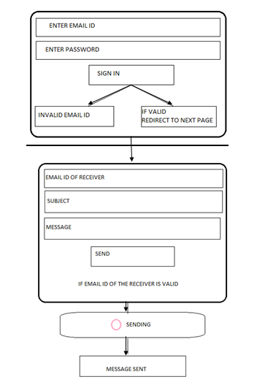

Slide 17
CONCLUSION
Using this application we can send mail from one mail id to another mail id. The created app is just a small version of sending mail.
As my created app is small version it only connect two id’s and send message but it can be enhanced for sending attachments such as video, photos, docs, pdf, moreover to keep record of mail sent and received.
A bigger and worldwide web has already been launched by google engine known as gmail with various advantages and lacks .
Although electronic mail servers and other mail transfer agent use SMTP to send and receive mail messages, user-level client mail applications typically use SMTP only for sending messages to a mail server for relaying.
ADVANTAGES OF GMAIL :- DISADVANTAGE OF GMAIL :-
JPG ,DOC,PDF etc files could be send Large amount of data cant be used
Fast Excess of internet is compulsory
Maintain security
Nowdays security has been increased by using OTP
Easy to access

Slide 18
FUTURE WORK
This is a basic app structure which maintains security as well as speed of sending message.
We could enhance it by attaching several types of files as follows:-
→JPG
→DOCS
→PDF
→PNG
→GIF
In general mail app lack property of sending high mb of data.
So in future we can develop this app for sending high amount of data. In order to make file transaction easier.

Slide 19
Thank -you
Presented by :- Kritika Pandey
B.Tech –CSE
40155102715
5 th sem (3 rd year)

